Slide 1
NMR Data Pre-processing
UAB Metabolomics Training Course
June 02-05, 2014
Susan Sumner, Wimal Pathmasiri, Rodney Snyder
NIH Eastern Regional Comprehensive Metabolomics Resource Core
(RTI RCMRC)
Notes:
One of 6 NIH cores.

Slide 2

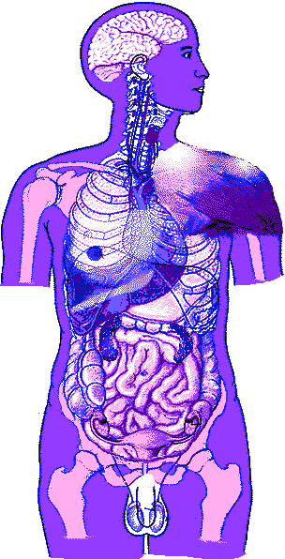
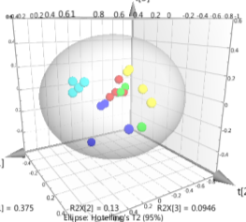
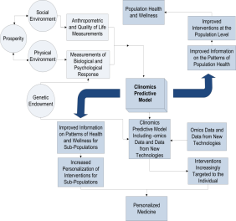
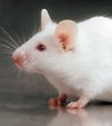
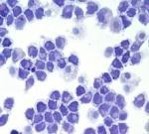
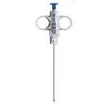

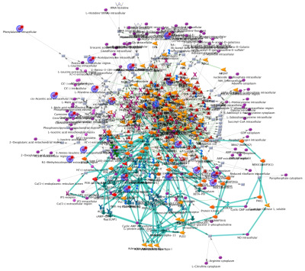
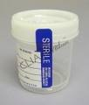
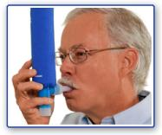
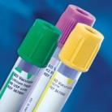
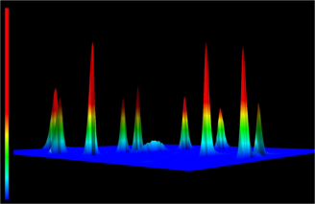
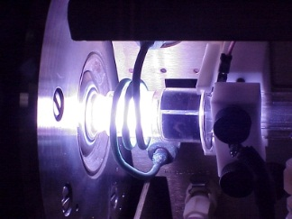
NIH Eastern Regional Comprehensive Metabolomics Resource Core at RTI
Data
Reduction & Visualization
Sample Receipt
Entry into BSI II
Discovery
&
Pathway
Mapping
Sample Preparation
QC Standards
Pooled Samples
Data Capture
& Storage
Communicating Results
Support for Experimental Design
Empirical &
Standards
Library Matching
LC-MS, MS/MS and Ion-Mobility
Multivariate and
Statistical Analysis
Predictive Modeling
BROAD
SPECTRUM
TARGETED
NMR
Pathway Mapping
Metabolites-Proteins-Genes
DRUG DISCOVERY • ENVIRONMENT• UROLOGY • IMMUNOLOGY • OBESITY • WOMEN’S HEALTH•
ICP-MS
Gc-MS
Notes:
This is an overview of our pipeline at the NIH Eastern RCMRC.
We will assist from study design to the end of metabolomics analysis.
One most important step in the study is the study design: If you design your study properly, they you can expect better results. You need to have a consistency especially in longitudinal studies. For example, you need to have the same anti-coagulant for all plasma samples and should be stored in the same way.
We have done metabolomics on many different types of biospecimens, urine, serum, plasma, feces, cord blood, saliva, mutltiple types of cells, and tissues. Each type may have a different preparation procedure..
We will run either targeted or broad spectrum metabolomics analysis. At RTI in our RCMRC we have 3 cores, NMR, LCMS, and GCMS.
We use multivariate and statistical analysis to separate study groups and find metabolites of interest.
And will assist in mapping those metabolites to biochemical pathways.

Slide 3
NMR Processing Steps
Chemical shift region (ppm)
Integral of bin region
Chenomx, ACD, AMIX
Spread Sheet Compatible Data Format
Peak AlignmentQC Check
Binned NMR Data
Sample Preparation
NMR
Data Acquisition
Raw NMR data
(FID)
Fourier Transform Phase and Baseline Correction
Processed NMR Spectrum
1r, cnx, esp, jdx
Multivariate Data Analysis
Statistical Analysis
Library Matched
Data
SIMCA P+
MATLAB 2011b including Simulink and Toolboxes (MathWorks, MA)
R Statistical Programming
Spotfire
Mapping
KEGG
GeneGo
Optimized methods (biofluids, tissues, urine)
QC samples prepared in parallel
Bruker Avance III NMR Spectrometer
TopSpin Software
Varian Unity Innova NMR Spectrometer
VNMR Software
Bruker Avance III NMR Spectrometer
TopSpin Software
Varian Unity Innova NMR Spectrometer
VNMR Software
SIMCA P+
MATLAB 2011b including Simulink and Toolboxes (MathWorks, MA)
R Statistical Programming
metabolite
concentration
Chenomx
AMIX
NMR data acquisition is performed by using methods cited in Beckonert et al. (2007), Nature Protocols, 2 (11), 2692-2703.

Slide 4
Data Pre-processing
Quality of metabolomics analysis depends on data quality
Typical problems
  Water peak
  Baseline
  Alignment of peaks (chemical shift)
  Variation in concentration
  High quality of data is needed

Slide 5
Data Pre-processing
After NMR data acquisition, the result is a set of spectra for all samples.
For each spectrum, quality of the spectra should be assessed.
  Line shape, Phase, Baseline
Spectra should be referenced
  Compounds commonly used: DSS, TSP, Formate
Variations of pH, ionic strength of samples has effects on chemical shift
  Peak alignment
  Bucket integration
  Remove unwanted regions
  Normalize data (remove variation in concentration of samples)

Slide 6
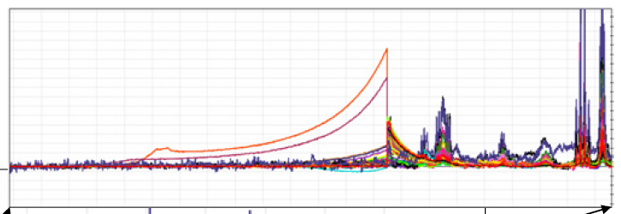
Water suppression effects
If water is not correctly suppressed or removed there will be effects on normalization
Need to remove other artifacts
Remove drug or drug metabolites

Slide 7
Data Pre-processing
Before
After
Phase
Baseline to be corrected
Reference, Line shape

Slide 8
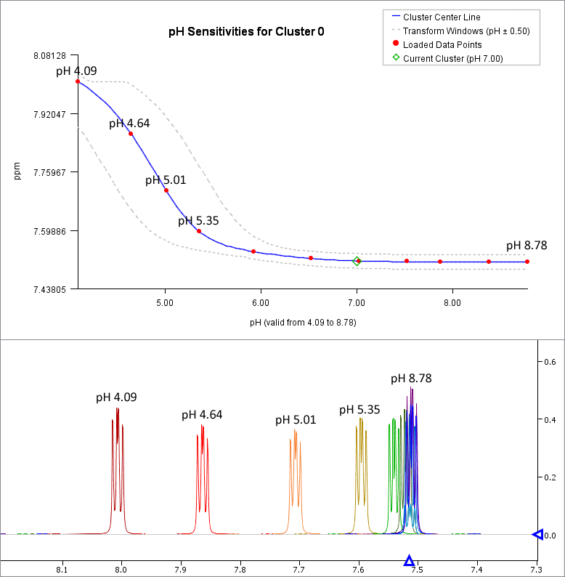
pH dependence of chemical shift
Chemical shift variability
pH
ionic strength
metal concentration
Methods to overcome this problem
Use a buffer when preparing samples
Binning (Bucketing)
  Fixed binning
  Intelligent binning
  Optimized binning
Data alignment
  Recursive Segment-wise Peak Alignment (RSPA)
  Icoshift
  speaq
http://www.chenomx.com/software/software.php
Savorani , F. et al, Journal of Magnetic Resonance, Volume 202, Issue 2, 2010, 190 – 202
Vu, T. N. et al., BMC Bioinformatics 2011, 12:405
Notes:
Factors such as pH, ionic strength can change the chemical shift of a particular proton. Using a buffered solution in sample preparation can be useful for avoiding situations like this. There are methods used to overcome this problem: binning or peak alignment

Slide 9
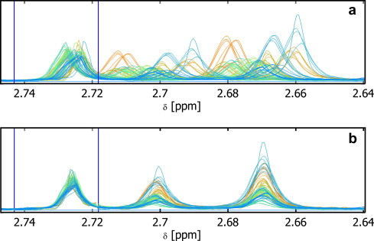
Peak alignment
Example
icoshift
before
after
Savorani , F. et al, Journal of Magnetic Resonance, Volume 202, Issue 2, 2010, 190 - 202
Notes:
Here is an example for using icoshift software for peak alignment.

Slide 10
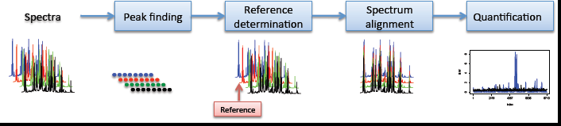
Example
speaq
Vu, T. N. et al., BMC Bioinformatics 2011, 12:405
Notes:
This shows the procedure for using R-based speaq software for aligning NMR spectra.

Slide 11
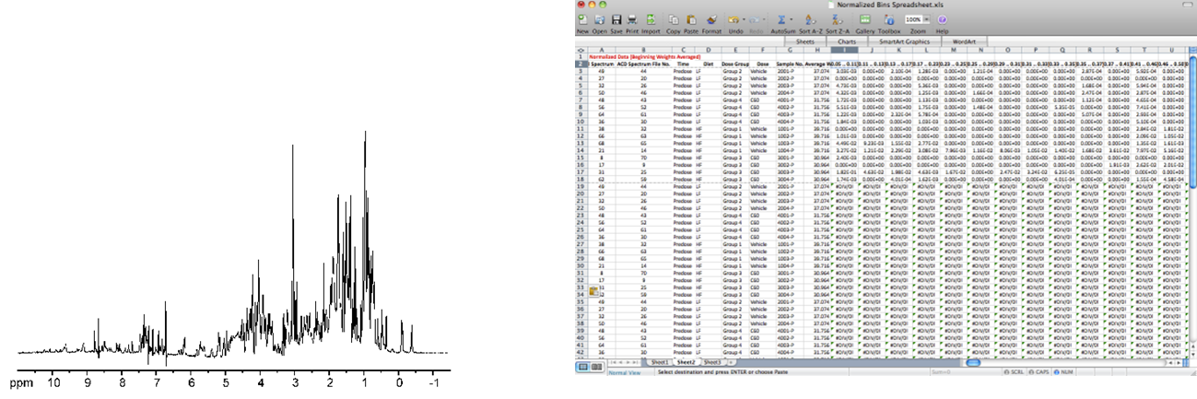
NMR Binning
A form of quantification that consists of segmenting a spectrum into small areas (bins/buckets) and attaining an integral value for that segment
Binning attempts to minimize effects from variations in peak positions caused by pH, ionic strength, and other factors.
Two main types of binning
  Fixed binning
  Flexible binning

Slide 12
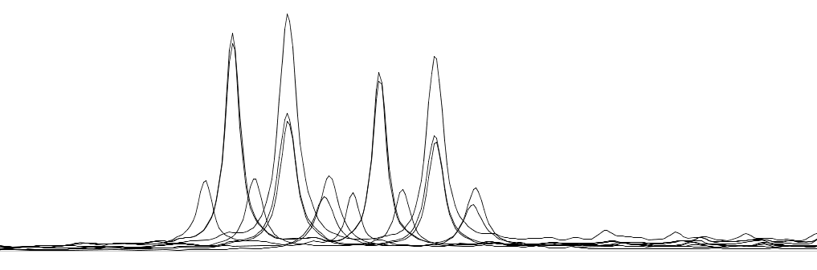
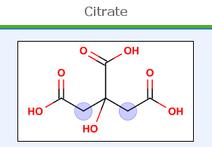
NMR Binning
The entire NMR spectrum is split into evenly spaced integral regions with a spectral window of typically 0.04 ppm.
The major drawback of fixed binning is the non-flexibility of the boundaries.
If a peak crosses the border between two bins it can significantly influence your data analysis
Peak shift can cause the same peak across multiple samples
to fall into different bins
Signals for citrate are split into multiple bins
Fixed Binning
2.58
2.56
2.54
2.52
2.50

Slide 13
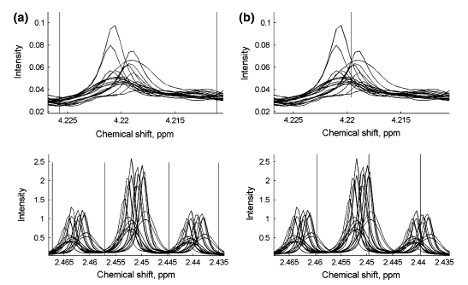
NMR Binning
This technique uses an algorithm to accurately determine binning windows based on the sample
By varying the width of your binning window you can ensure a more complete capture of a peak
Flexible Binning
Fixed Binning
Bin is correctly determined. Peak is more properly captured
Peaks are split into multiple bins regardless of peak location
Anderson et al. 2010

Slide 14
NMR Binning
Signals for citrate are split into multiple bins
Fixed Binning
2.58
2.56
2.54
2.52
2.50
Signals for citrate are properly captured
Smart Binning

Slide 15
Binning
Samples

Slide 16
Remove regions
Downfield region
DSS and up field
Urea
Water

Slide 17
Data Normalization
Variations in concentration across samples
  Urine concentration
Sample to sample variability need to be removed
Normalize
  To a peak that is always present in he same concentration
  To the total integral of the spectrum
  Probabilistic quotient normalization

Slide 18
Data Normalization
Variations in concentration across samples
  Urine concentration
Sample to sample variability need to be removed
Normalize
  To a peak that is always present in he same concentration
  To the total integral of the spectrum
  Probabilistic quotient normalization

Slide 19
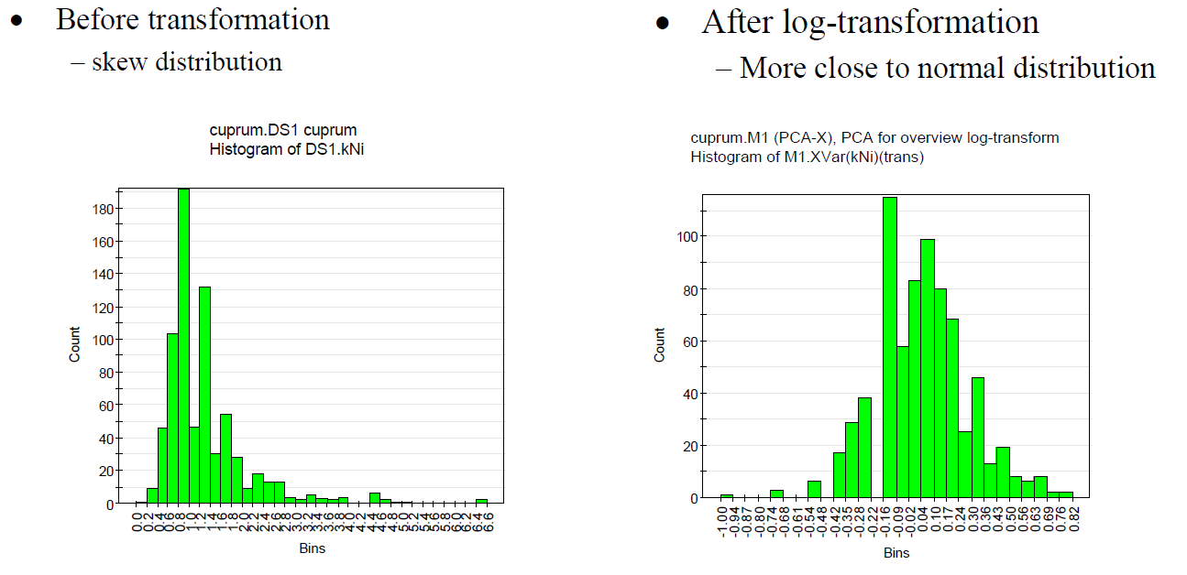
Data Transformation
Susan Wicklund, Multivariate data analysis for omics, Sept 2-3 2008, Umetrics training

Slide 20
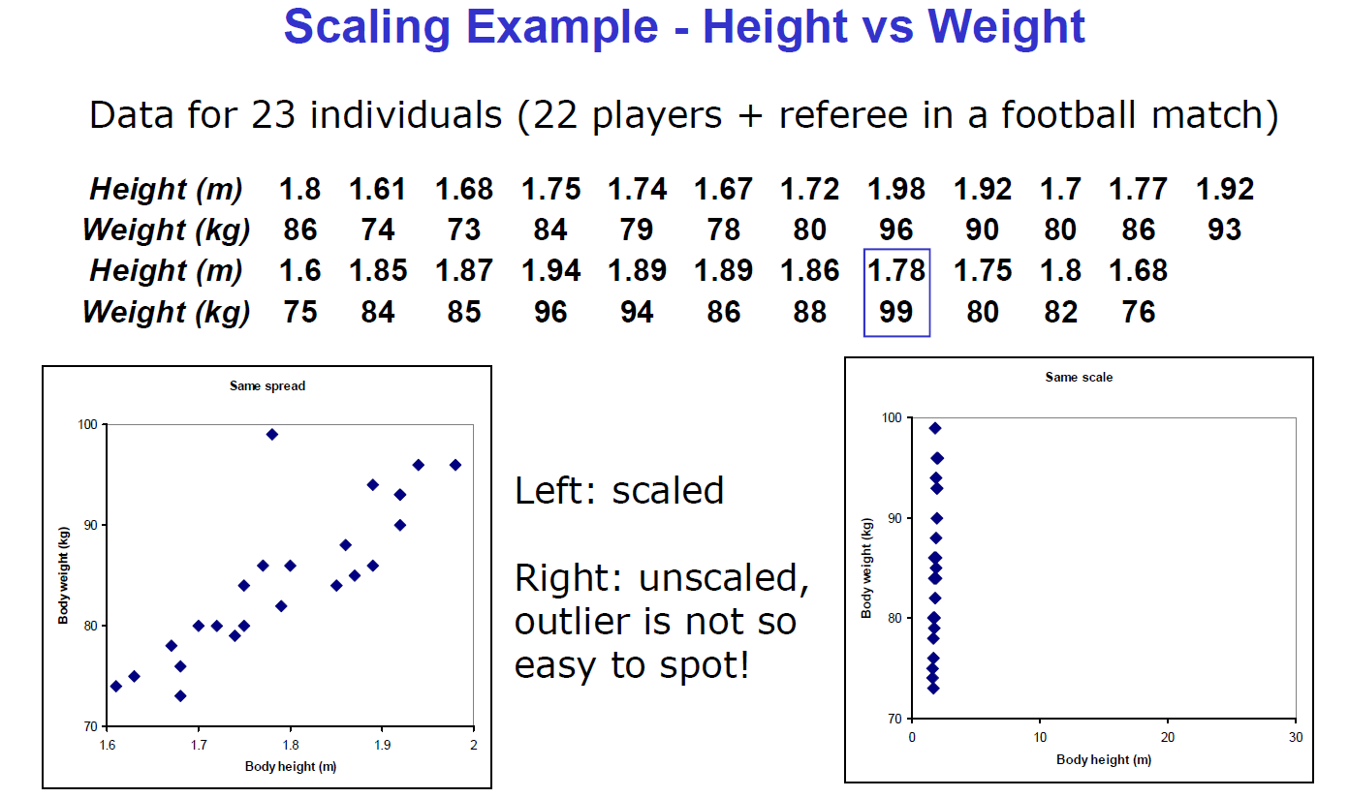
Data Scaling
Susan Wicklund, Multivariate data analysis for omics, Sept 2-3 2008, Umetrics training

Slide 21
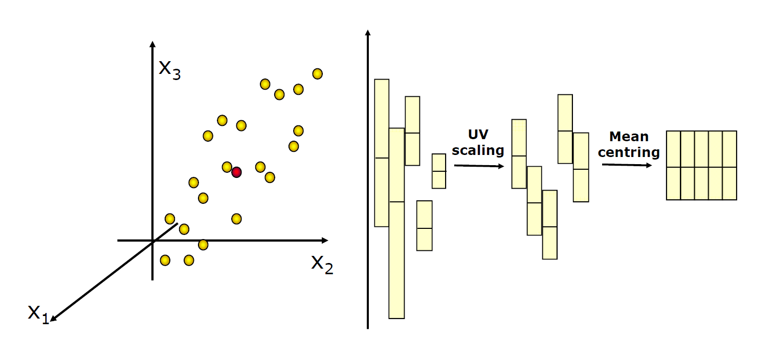
Data Scaling
Susan Wicklund, Multivariate data analysis for omics, Sept 2-3 2008, Umetrics training

Slide 22
Scaling methods
Many methods
  Centering (Ctr)
  Unit variance (UV)
  Pareto (Par)
  Unit variance without centering
  Pareto scaling without centering
For metabolomics data, Pareto Scaling is a good alternative
  Intermediate between UV and Ctr

Slide 23
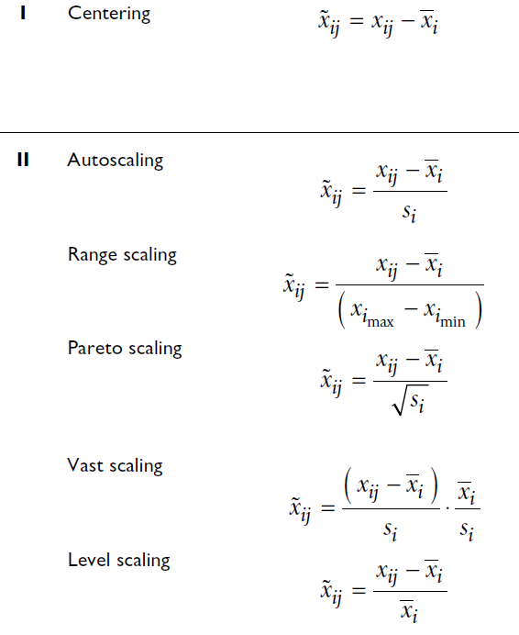
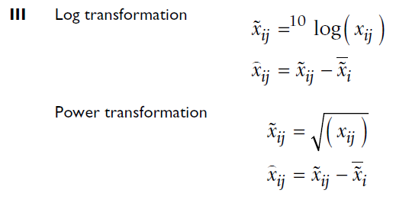
Scaling methods
Analysis results vary depending on the scaling/ transformation methods used.
Van den Berg et al 1006, BMC Genomics, 7, 142

Slide 24
Scaling methods
Unit variance (UV) vs no scaling
  In UV, each variable is divided by standard deviation
  UV increases baseline noise
  If no scaling is used, peaks with medium intensities will be overwhelmed by big peaks
Pareto scaling
  Divide each variable by square root of standard deviation
  Intermediate between no scaling and unit variance

Slide 25
Integrate bins (0.04 ppm bin size)
Normalize integral of each bin to the total integral of each spectrum
Merge metadata
Result is a spreadsheet ready for further multivariate data analysis and other statistical analysis
Binning
Sample ID | Disease Group | [0.40 .. 0.46] | [0.46 .. 0.52] | [0.52 .. 0.54] | [0.54 .. 0.57] | [0.57 .. 0.60] | [0.60 .. 0.66] | [0.66 .. 0.68] | [0.68 .. 0.71] | [0.71 .. 0.75]
C0559 | Cases | 7.60E-05 | 0.00E+00 | 7.32E-02 | 8.48E-02 | 3.20E-02 | 1.84E+00 | 1.31E-01 | 3.60E-01 | 3.67E-01
C0629 | Cases | 0.00E+00 | 1.78E-02 | 0.00E+00 | 2.18E-02 | 0.00E+00 | 1.08E+01 | 0.00E+00 | 0.00E+00 | 3.02E-02
C0640 | Cases | 3.44E-04 | 0.00E+00 | 1.83E-03 | 1.86E-04 | 0.00E+00 | 4.51E+00 | 0.00E+00 | 0.00E+00 | 0.00E+00
C0835 | Cases | 6.41E-04 | 0.00E+00 | 6.44E-03 | 0.00E+00 | 3.96E-03 | 3.28E+00 | 0.00E+00 | 5.12E-03 | 1.75E-02
D0613 | Cases | 6.63E-03 | 0.00E+00 | 0.00E+00 | 1.06E-02 | 0.00E+00 | 5.79E+00 | 0.00E+00 | 6.36E-02 | 3.02E-01
D0762 | Cases | 0.00E+00 | 0.00E+00 | 1.79E-02 | 1.98E-02 | 0.00E+00 | 9.37E+00 | 0.00E+00 | 0.00E+00 | 1.74E-02
D1113 | Cases | 3.14E-03 | 2.42E-03 | 8.02E-02 | 1.04E-01 | 5.32E-03 | 3.74E+00 | 0.00E+00 | 2.02E-02 | 1.84E-01
D1158 | Cases | 0.00E+00 | 3.71E-03 | 2.35E-02 | 4.83E-02 | 0.00E+00 | 5.02E+00 | 0.00E+00 | 1.91E-02 | 0.00E+00
D2090 | Cases | 0.00E+00 | 0.00E+00 | 2.45E-03 | 9.98E-04 | 0.00E+00 | 5.76E+00 | 0.00E+00 | 1.24E-02 | 1.04E-02
E0004 | Cases | 1.72E-03 | 0.00E+00 | 6.85E-02 | 3.05E-02 | 0.00E+00 | 1.47E+00 | 6.90E-02 | 3.61E-01 | 4.08E-01
E0195 | Cases | 0.00E+00 | 1.69E-03 | 5.57E-02 | 6.29E-02 | 0.00E+00 | 2.77E+00 | 1.34E-01 | 2.04E-01 | 4.56E-01
E0225 | Cases | 1.25E-03 | 0.00E+00 | 4.40E-03 | 1.69E-02 | 0.00E+00 | 9.17E+00 | 0.00E+00 | 1.08E-02 | 2.30E-02
E0309 | Cases | 4.11E-03 | 0.00E+00 | 2.23E-02 | 7.54E-03 | 3.08E-03 | 3.54E+00 | 0.00E+00 | 3.28E-02 | 9.09E-01
E0487 | Cases | 1.72E-03 | 0.00E+00 | 0.00E+00 | 1.00E-02 | 0.00E+00 | 4.00E+00 | 0.00E+00 | 1.36E-02 | 0.00E+00
F0036 | Cases | 1.66E-02 | 0.00E+00 | 0.00E+00 | 2.06E-02 | 0.00E+00 | 1.22E+01 | 1.04E-02 | 0.00E+00 | 5.97E-01
F0108 | Cases | 0.00E+00 | 2.31E-03 | 6.30E-03 | 1.11E-02 | 0.00E+00 | 7.17E+00 | 0.00E+00 | 1.65E-02 | 2.21E-01
A0233 | Control | 0.00E+00 | 1.86E-02 | 0.00E+00 | 1.82E-02 | 0.00E+00 | 1.61E+01 | 0.00E+00 | 2.91E-03 | 0.00E+00
A0490 | Control | 0.00E+00 | 0.00E+00 | 2.99E-03 | 3.60E-02 | 0.00E+00 | 2.97E+00 | 0.00E+00 | 4.00E-02 | 5.46E-01
A2003 | Control | 0.00E+00 | 0.00E+00 | 3.45E-02 | 2.20E-02 | 0.00E+00 | 1.80E+00 | 0.00E+00 | 0.00E+00 | 0.00E+00
C0586 | Control | 0.00E+00 | 1.69E-02 | 0.00E+00 | 6.64E-03 | 0.00E+00 | 1.92E+01 | 0.00E+00 | 6.51E-02 | 0.00E+00
C2177 | Control | 0.00E+00 | 0.00E+00 | 3.02E-02 | 3.59E-02 | 0.00E+00 | 2.35E+00 | 0.00E+00 | 3.19E-02 | 1.49E-01
D0177 | Control | 9.21E-03 | 0.00E+00 | 1.69E-02 | 1.47E-02 | 0.00E+00 | 2.43E+00 | 0.00E+00 | 4.46E-02 | 0.00E+00
D0729 | Control | 0.00E+00 | 1.88E-03 | 5.58E-02 | 7.87E-02 | 2.92E-02 | 3.16E+00 | 6.59E-02 | 2.80E-01 | 4.30E-01
D0909 | Control | 0.00E+00 | 1.08E-03 | 0.00E+00 | 5.69E-03 | 0.00E+00 | 2.49E+00 | 0.00E+00 | 1.01E-02 | 1.87E-01
D0945 | Control | 0.00E+00 | 4.79E-04 | 7.00E-03 | 0.00E+00 | 4.19E-03 | 3.99E+00 | 0.00E+00 | 1.11E-03 | 3.96E-02
D1174 | Control | 0.00E+00 | 9.33E-04 | 0.00E+00 | 3.43E-03 | 1.30E-02 | 7.21E+00 | 6.53E-03 | 0.00E+00 | 1.66E-02
D2054 | Control | 1.55E-03 | 0.00E+00 | 0.00E+00 | 1.22E-02 | 0.00E+00 | 2.07E+00 | 0.00E+00 | 1.28E-02 | 3.90E-01
D2062 | Control | 2.39E-05 | 0.00E+00 | 6.04E-02 | 2.99E-02 | 0.00E+00 | 4.94E+00 | 0.00E+00 | 9.95E-03 | 0.00E+00
D2079 | Control | 2.73E-02 | 0.00E+00 | 1.81E-03 | 1.17E-02 | 0.00E+00 | 3.38E+01 | 7.87E-02 | 0.00E+00 | 5.91E+00

Slide 26
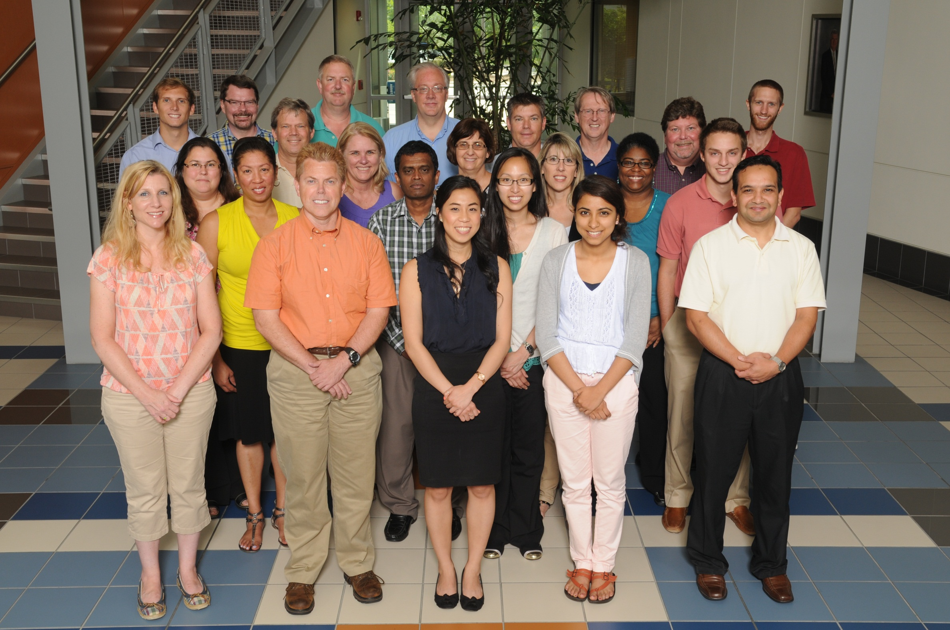
Thank you
Notes:
The RTI RCMRC. Susan and Wimal are here this week.

